Slide 1
Phase 1 project
Aviation accident analysis based on various parameters.
Notes:
BY COLLINS KIPTOO

Slide 2
OVERVIEW
This project involves analyzing aviation data to create Tableau dashboards that assist in making informed decisions about purchasing aircraft. The dashboards are designed to provide insights into safety, performance, cost-effectiveness, and regional trends. The analysis is based on a dataset containing information about aviation incidents, including aircraft make and model, injury severity, weather conditions, and more.

Slide 3
PURPOSE AND INTRODUCTION
This project focuses on leveraging historical aviation incident data to guide informed decisions regarding aircraft purchases. By analyzing safety records, performance metrics, and operational contexts, we aim to identify the most reliable, cost-effective, and safe aircraft models.
The analysis is centered around creating actionable Tableau dashboards, designed for stakeholders in the aviation industry such as fleet managers, safety analysts, and procurement teams.

Slide 4
DATA LOADING AND CLEANING
The first thing was to import all the necessary libraries in order to begin analyzing the data.
Data cleaning include:
Checking on the data missing
Removing duplicates
Replacing missing values
Checking for outliers
Adding more columns for better analysis.

Slide 5
DATA VISUALIZATION
After data cleaning I began plotting chats using seaborn and matplotlib to help me analyze the data based on my objectives and considering my problem statement.

Slide 6
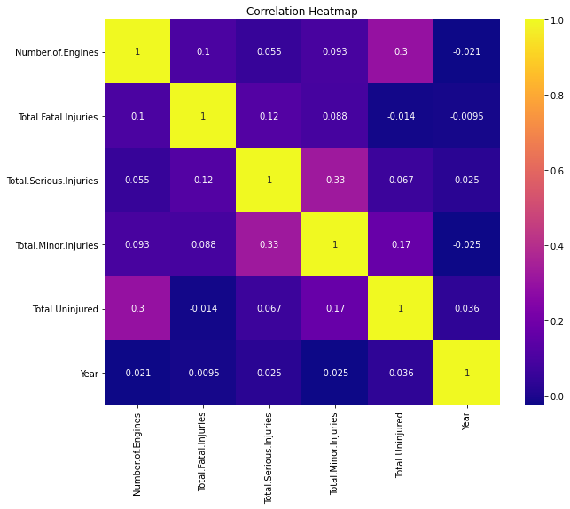
Correlation heatmap

Slide 7
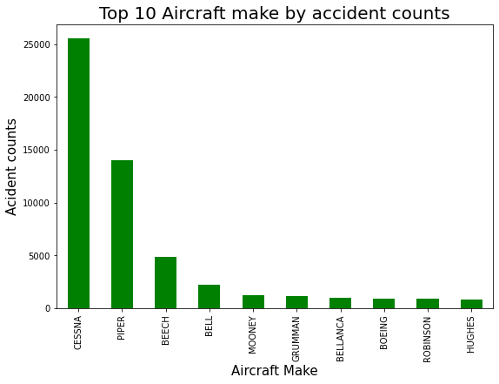
Top 10 Aircraft make by accident counts

Slide 8
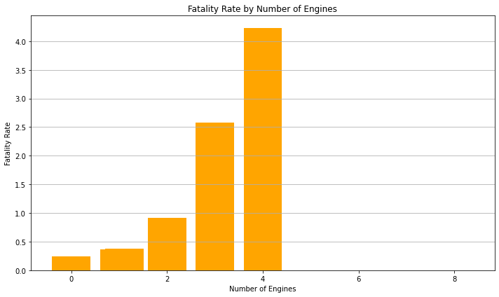
Fatality Rate by Number of Engines

Slide 9
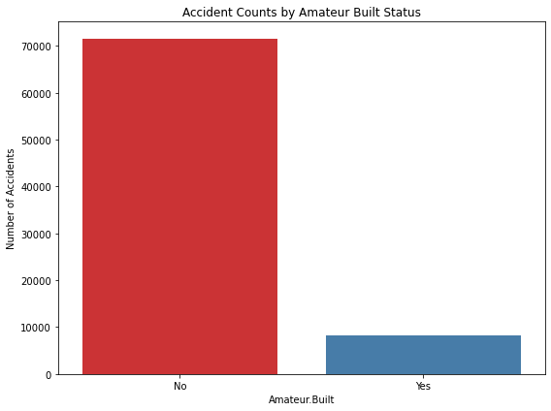
Accident Counts by Amateur Built Status

Slide 10
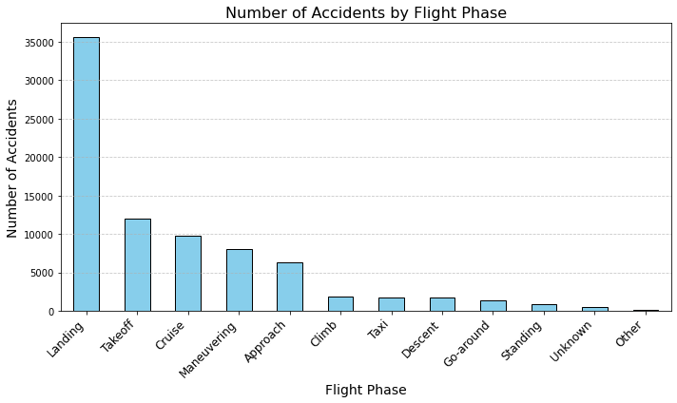
Number of Accidents by Flight Phase

Slide 11
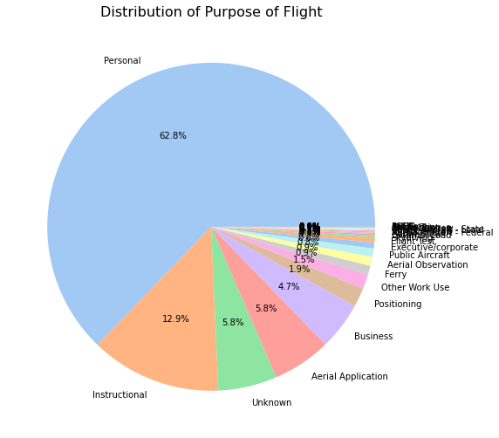
Distribution of Purpose of Flight

Slide 12
CONCLUSION
Conclusion The analysis of aviation event data reveals key trends that are essential for guiding the sales and marketing strategies of aircraft manufacturers. The following conclusions can be drawn:
Safety is a Top Priority: Manufactures should prioritize on aircraft with few accidents.
Technological Advancements Drive Sales: Modern aircraft equipped with advanced weather navigation and safety systems are better positioned in the market, especially under challenging conditions.
Customization for Purpose: Aircraft sales are heavily influenced by their purpose
Impact of Historical Trends: Certain manufacturers consistently exhibit strong performance and safety records, making them market leaders in specific segments.

Slide 13
RECOMMENDATIONS
1. Safety Enhancements:
Manufacturers should prioritize safety features for aircraft models associated with higher injury severity rates or damage.
Enhanced weather navigation systems could reduce incidents under Instrument Meteorological Conditions (IMC), which are linked to a higher number of accidents.
2. Data-Driven Design:
Aircraft manufacturers should use accident data to refine designs, focusing on reducing damage during critical phases of flight (e.g., cruise and approach).
Invest in technology that addresses recurring issues found in older models or designs with higher accident rates.
3. Targeted Marketing:
Focus on promoting models with excellent safety records for specific purposes of flight, such as commercial, recreational, or training purposes.
Emphasize models with proven durability and resilience in diverse weather conditions.
4. Regulatory Collaboration:
Collaborate with aviation authorities to establish stricter safety regulations for amateur-built aircraft, as these may exhibit a higher accident rate.
5. Customer Education:
Provide comprehensive training and support for operators of high-performance models to ensure optimal handling and maintenance

